Slide 1
LINUX AND SHELL SCRIPTING

Slide 2
Learning Outcomes
Understand the Network Interfacing Tool
Connect to LAN using static and dynamic addresses
Understand DNS

Slide 3
Connecting to the Internet
First, we need to configure our system before that connection can take place.

Slide 4
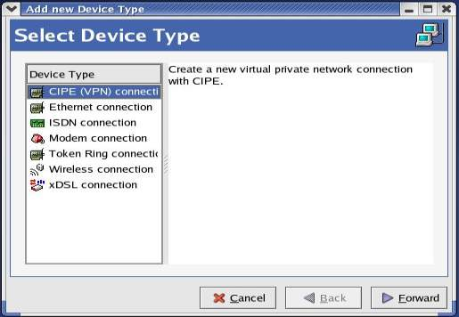
Internet Configuration Wizard
Enter the Internet Configuration Wizard (Main Menu | System Tools | Internet Configuration Wizard):

Slide 5
Network Interfacing Tool
Network Interfacing Tool is also known as the Network Administration Tool or Network Configuration Tool.

Slide 6
Connecting to LAN
A network device connected to a TCP/IP network has an IP address associated with it, such as 192.168.100.20.
Using the IP address of a machine, other machines on the network can address it uniquely.

Slide 7
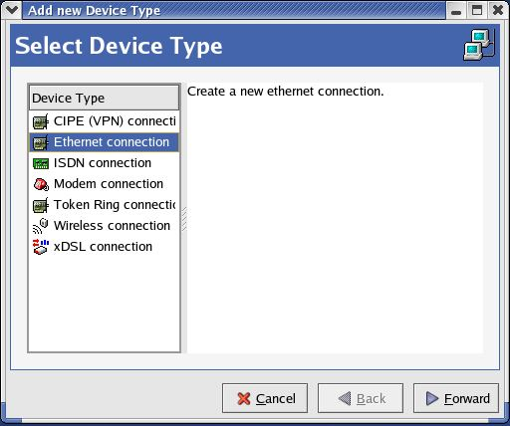
Connecting to the LAN

Slide 8
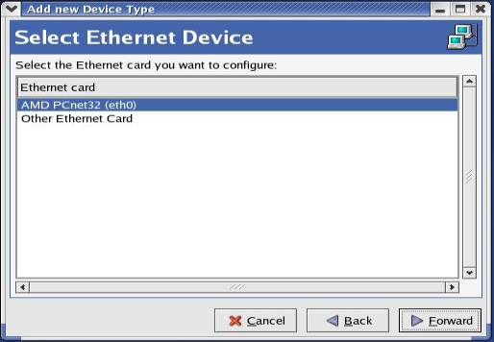
Select Ethernet Device

Slide 9
IP address
Static IP addresses
Dynamic IP addresses

Slide 10
Static IP Address
For a machine connected to a LAN or ISP using a static IP address, we need to obtain the network details such as the IP Address, the Subnet Mask for the network, and the Default Gateway Address which is the IP address of a router for the network.

Slide 11
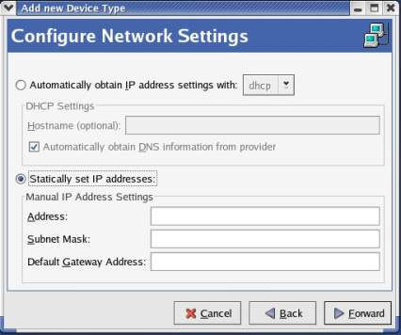
IP Address

Slide 12
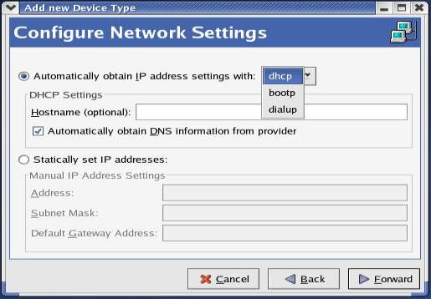
Dynamic IP Address

Slide 13
Dynamic IP Address
Dynamic IP addresses are distributed and managed via dynamic address allocation protocols.
In the case of a machine connected to a LAN using a dynamic IP address, the address is allocated either using the DHCP or BOOTP.
For ISPs that use PPPoE, the address is allotted by the PPPoE protocol, in which case we need to choose dialup.

Slide 14
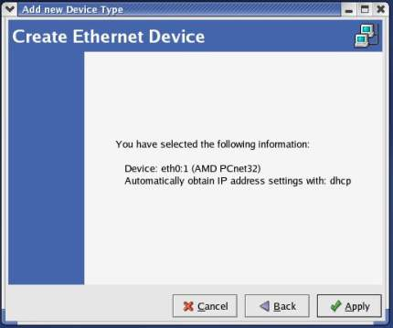
Process

Slide 15
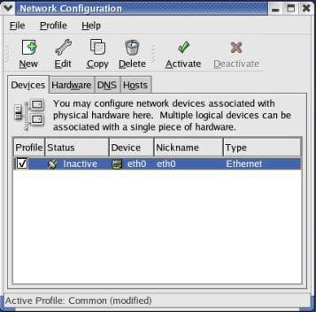
Process

Slide 16
Network Interfacing Tool
Devices Tab
Hardware Tab
DNS Tab
Hosts Tab

Slide 17
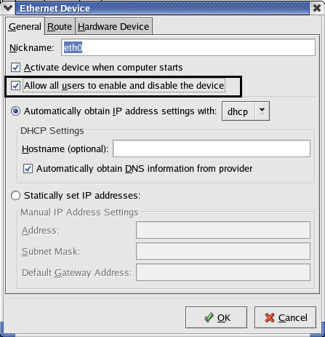
Process

Slide 18
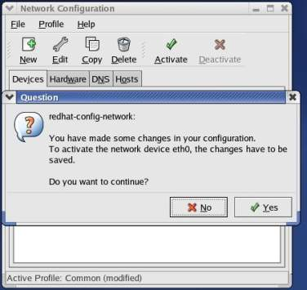
Process

Slide 19
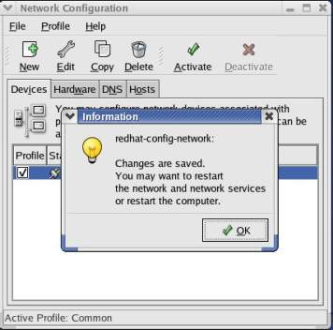
Process

Slide 20
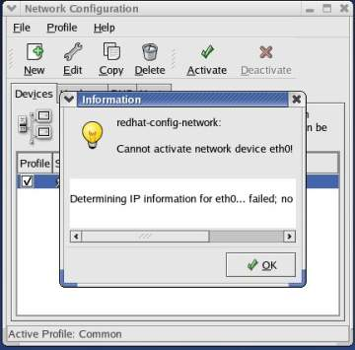
Process

Slide 21
Process
First file
#gedit /etc/sysconfig/network-scripts/ifcfg-eth0
Second file
#gedit /etc/sysconfig/networking/devices/ifcfg-eth0
Third file
#gedit/etc/sysconfig/networking/profiles/default/ifcfg-eth0

Slide 22
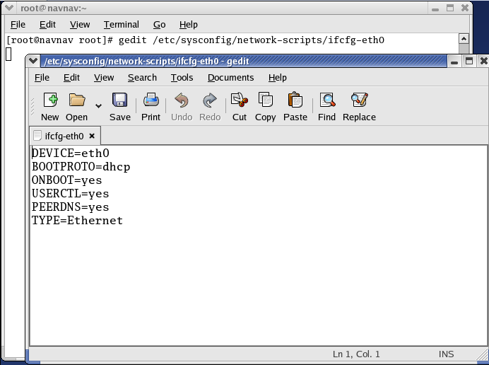
Process
.

Slide 23
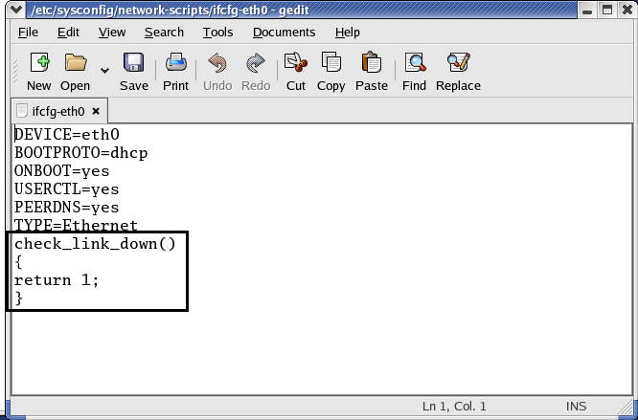
Process

Slide 24
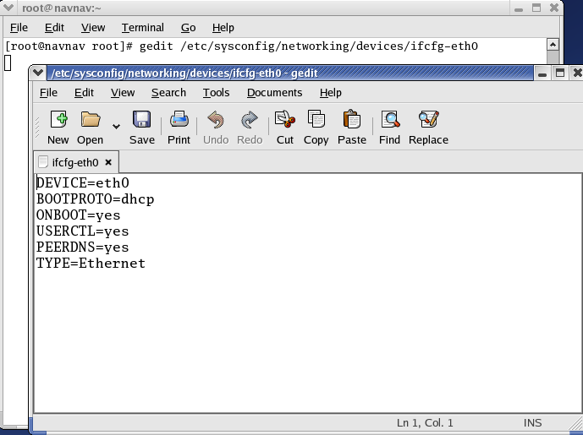
Process

Slide 25
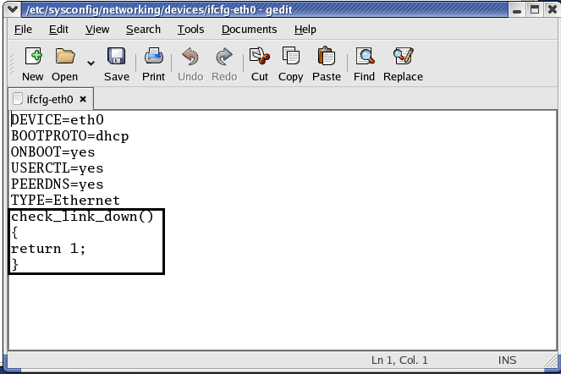
Process

Slide 26
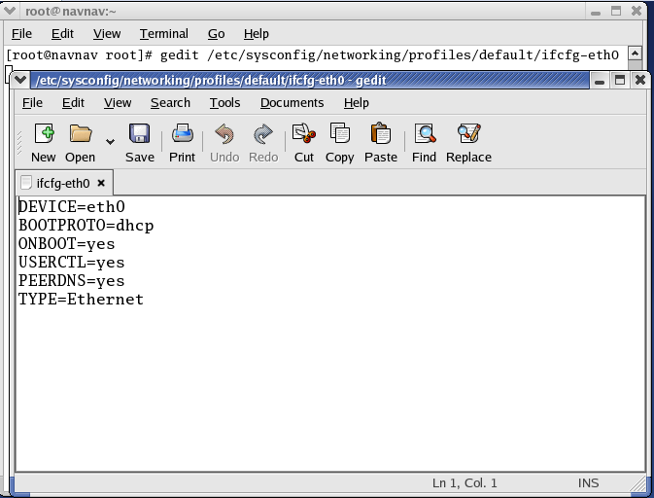
Process

Slide 27
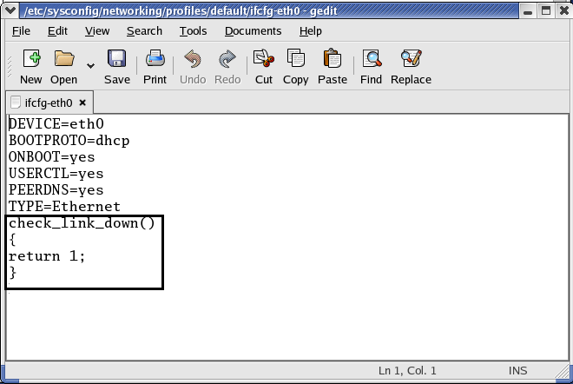
Process

Slide 28
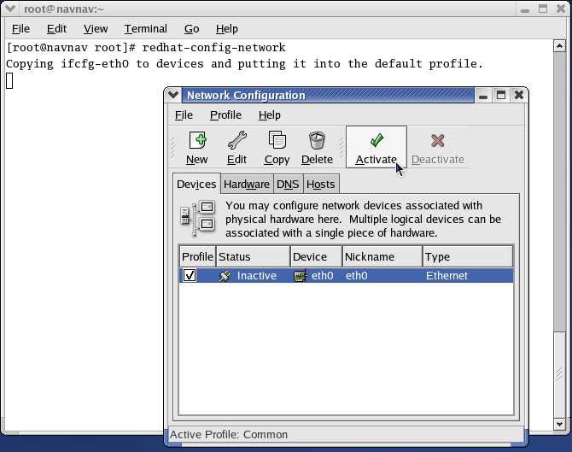
Process

Slide 29
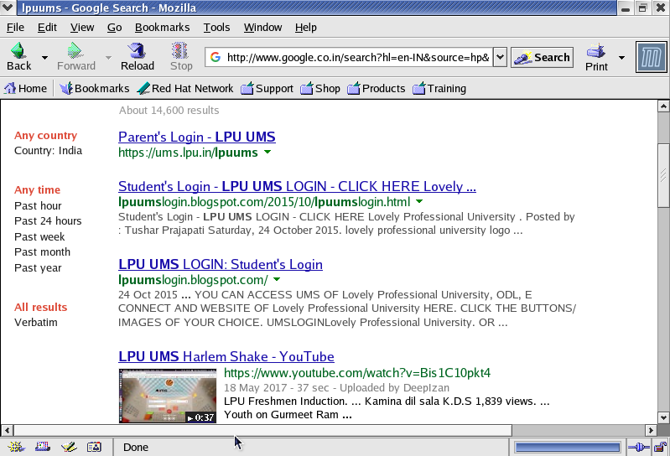
Process

Slide 30
DNS
Rather than remember the IP address of the Wrox web site, it is easier for us to remember www.wrox.com.
Domain Name System (DNS) servers provide the mapping between human−readable addresses (such as www.wrox.com) and the IP addresses of the machines acting as the web servers for the corresponding web service.

Slide 31
DNS
Applications such as web browsers and e−mail clients require the IP address to connect to a web site or a mail server respectively.
In order to get this from the human−readable input that we provide them with, they query a DNS server for the corresponding IP address information.

Slide 32
DNS
Obviously, this also means that the browser and other clients on the machine need to know the IP address of the DNS server.
For machines that use DHCP, the information about the DNS server is automatically available when the machine is configured.

Slide 33
Commands
#redhat-config-network //to open network configuration manager
ifconfig // to get information about active network
ping //used to test the reachability of a host

